Slide 1

Tyler Reno
MIS 665 Final Presentation

Slide 2
Project Description and Introduction
Purpose
Business Problem
Context
Business Questions

Slide 3
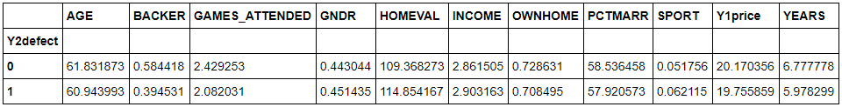
Analysis Key Findings from data visualization

Slide 4
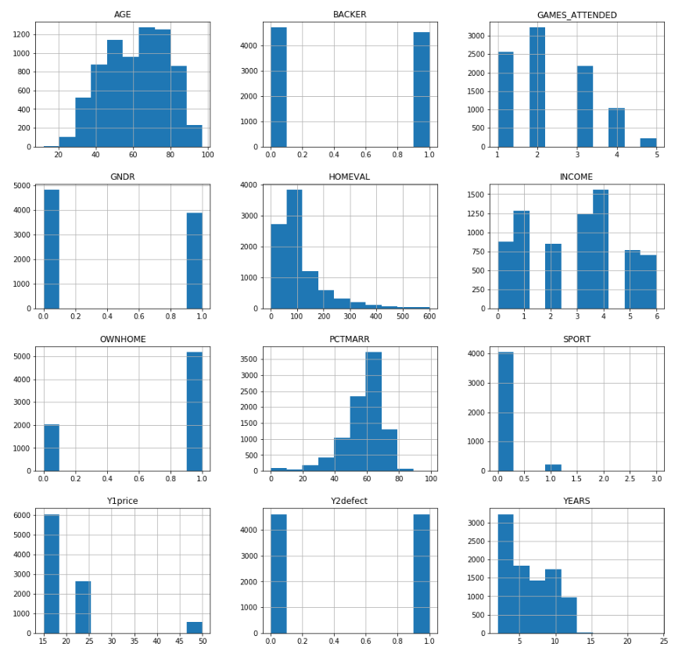
Analysis Key Findings from data visualization

Slide 5
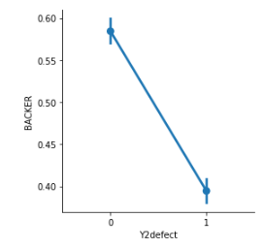
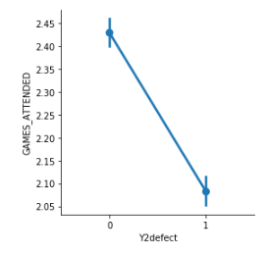
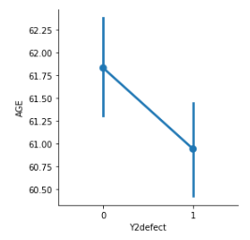
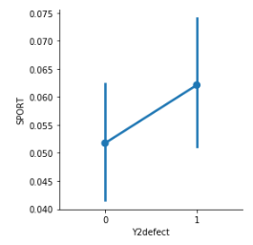
Analysis Key Findings from data visualization
1. 2. 3. 4.

Slide 6
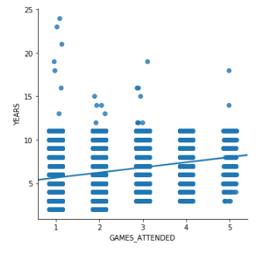
Analysis Key Findings from data visualization

Slide 7
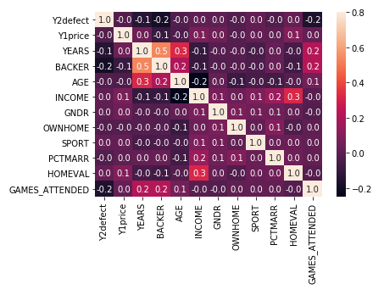
Analysis Key Findings from exploratory data analysis
Backer (-0.19)
Games Attended (-0.16)
Years (-0.14)

Slide 8
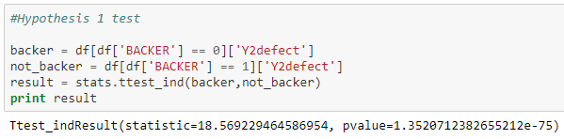
Analysis Key Findings from exploratory data analysis
Hypothesis 1 - I predict that being a backer has a significant impact on whether or not a season ticket holder renews their season pass because if somebody is willing to donate money to KSU they are likely dedicated fans and also have the financial means to renew their pass.
TRUE

Slide 9
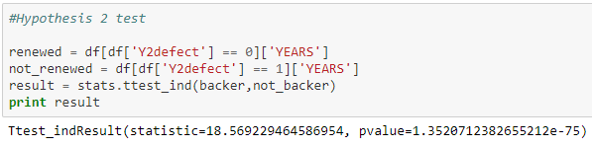
Analysis Key Findings from exploratory data analysis
Hypothesis 2 - I predict that the number of years has a significant impact on whether or not a season ticket holder renews their season pass because if they have had a season pass for several years, they might be more likely to continue holding one, as opposed to somebody that's only had a season pass for one year and might not know if it's really worth it to them yet.
TRUE

Slide 10
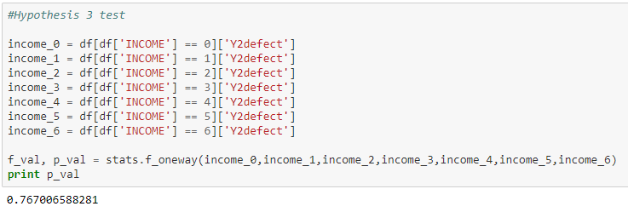
Analysis Key Findings from exploratory data analysis
Hypothesis 3 - I predict that the income level of an individual has a significant impact on whether or not a season ticket holder renews their season pass because somebody with a higher level of income has greater means to renew their season pass.
FALSE

Slide 11
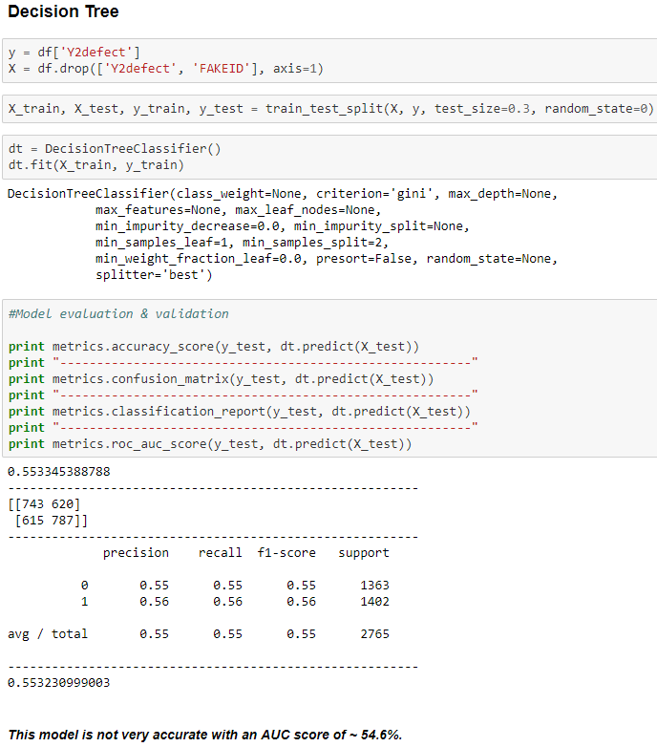
Analysis Classification Models
Not great

Slide 12
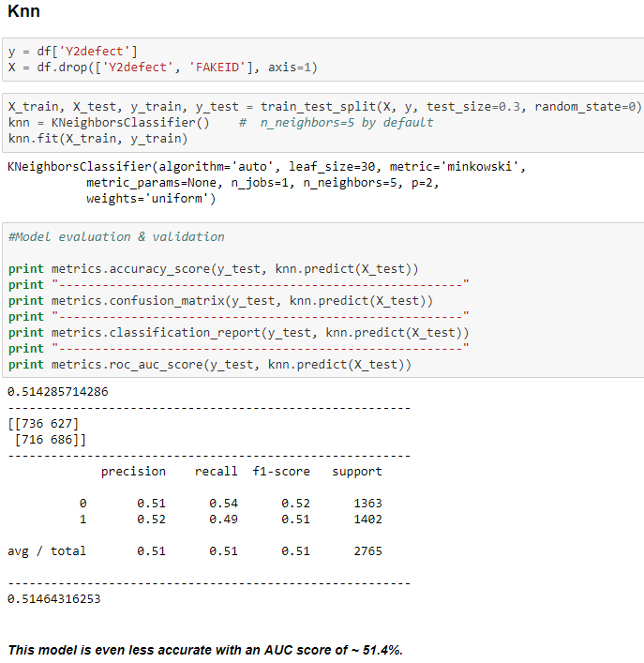
Analysis Classification Models
Even less great

Slide 13
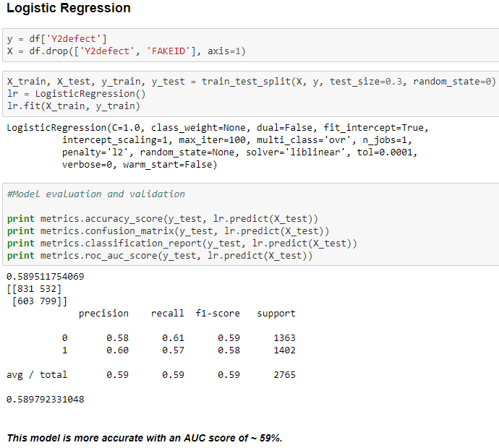
Analysis Classification Models
Getting better

Slide 14
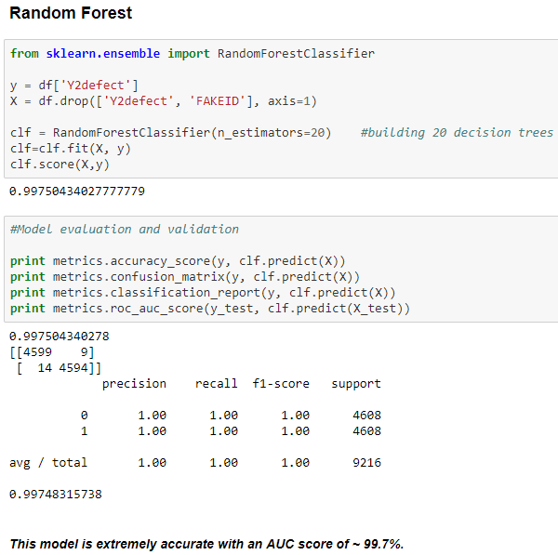
Analysis Classification Models
Extremely accurate
Misleading

Slide 15
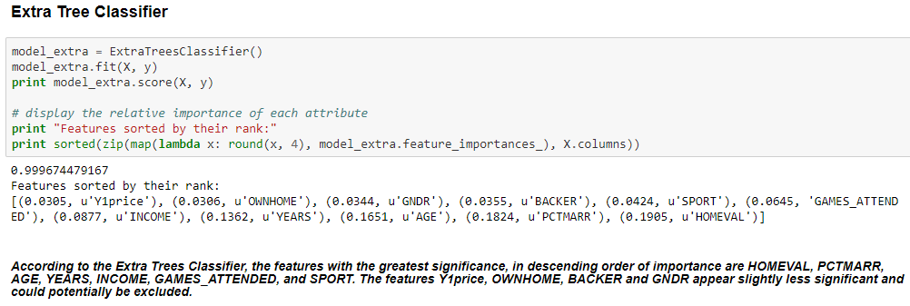
Analysis Classification Models – Feature Selection

Slide 16
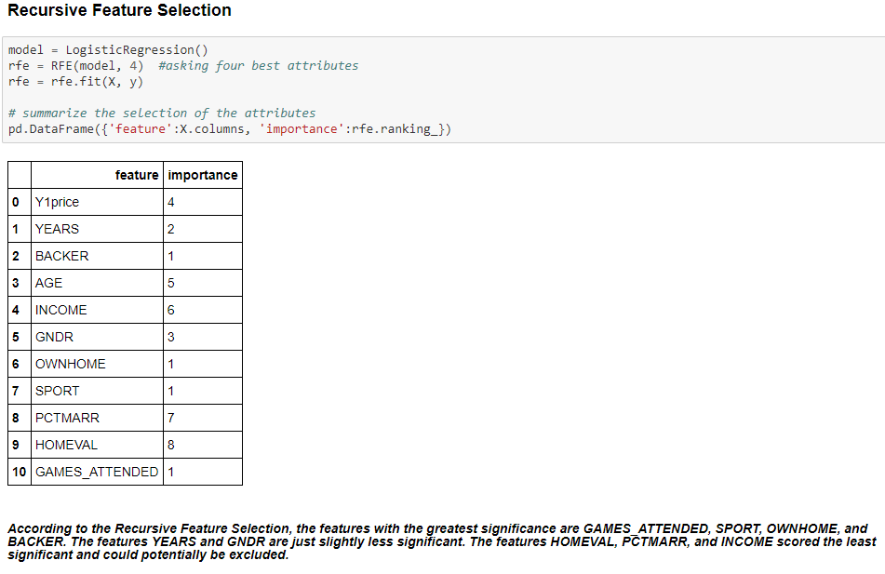
Analysis Classification Models – Feature Selection

Slide 17
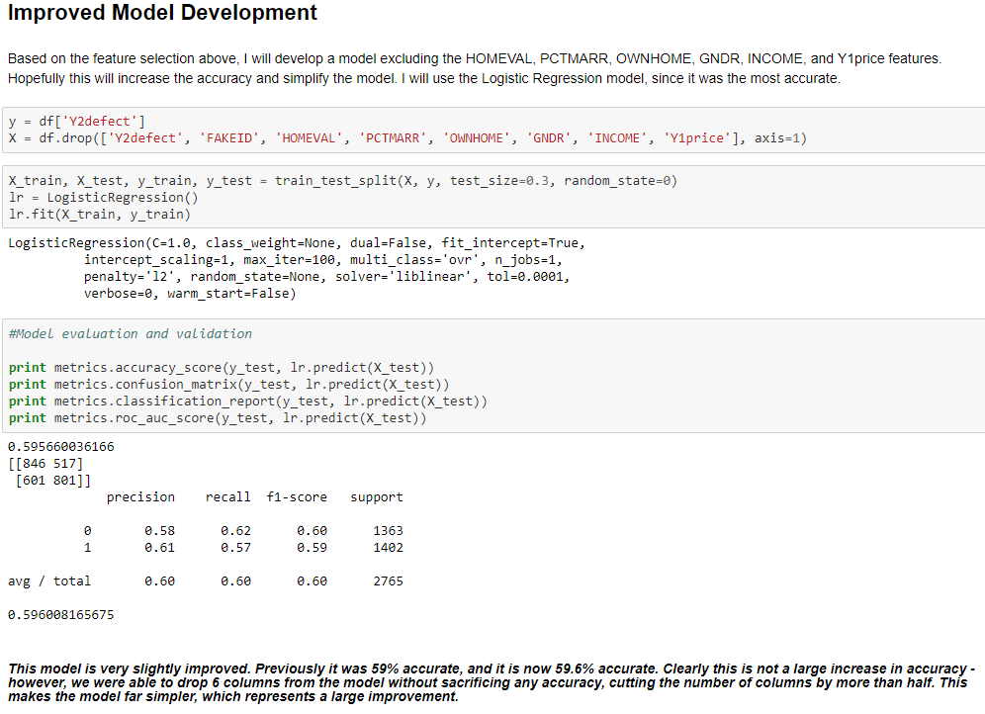
Analysis Classification Models – Improved Model Development

Slide 18
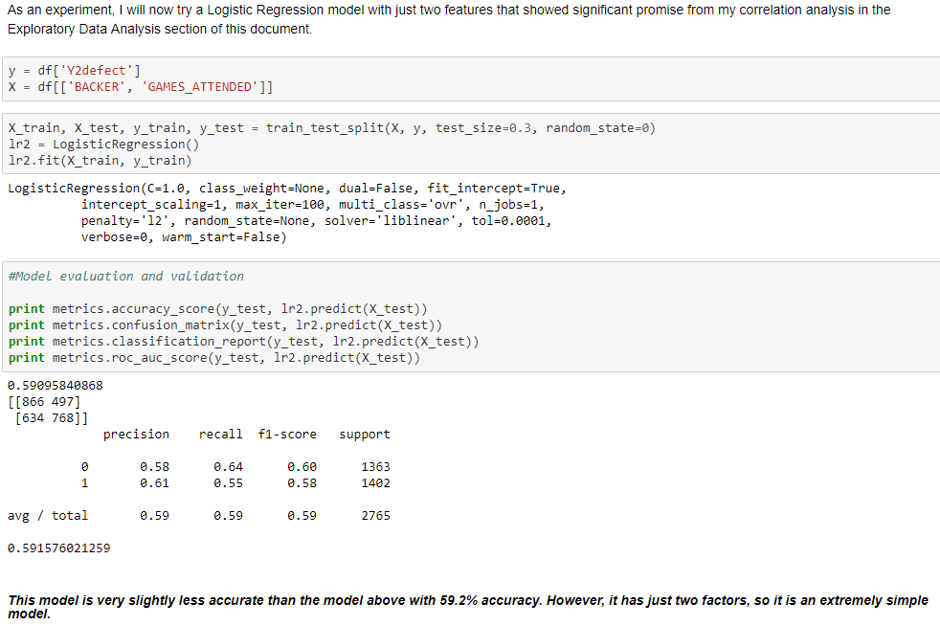
Analysis Classification Models – Improved Model Development

Slide 19
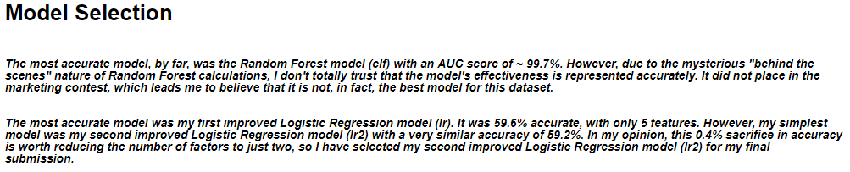
Analysis Classification Models – Model Selection
Final Model
Logistic Regression
Backer & Games Attended
59.2% accurate

Slide 20
Storytelling Most likely to renew
People who are most likely to renew their season passes:
Are backers
Attend most of the games
Are of an older age
Have had season passes for several years
Do not subscribe to sports magazines
K-State should not be concerned about these people leaving.

Slide 21
Storytelling Most likely to defect
People who are most likely to defect:
Own a season pass but are not backers
Do not attend many games
Are young
Have only had a season pass for one season
Subscribe to sports magazines
K-State should contact these people with promotions, reminders, etc.

Slide 22
Storytelling Advice for K-State
Use my simplest model
Logistic Regression
Backer, Games Attended
Only sacrifice 0.4% accuracy – 59.2% accuracy
Benefits
Simple
Information is readily available

Slide 23
Storytelling Advice for K-State
Target season pass holders that the model identifies as “high risk”.
Offer promotions, reminders, fan letters, K-State news, etc.
Encourage season pass holders to become backers.
Encourage season pass holders to attend many games.

Slide 24
Storytelling Additional Variables
The following information could be beneficial in predicting whether or not a season pass holder will renew their pass:
The win/loss record of the team for the previous season
If the season pass holder has a child attending K-State that year (and if they were graduating)
If the season pass holder had a child playing on the team that year (and if they were graduating)
The team’s predicted standings for the upcoming season

